Slide 1
2º FPB Comercio
UNIT 1: Vocabulary
JOBS

Slide 2
Seller
Cashier
Telemarketer
Customer service representative
Trade representative
Online content manager
Store manager
Responsible for receiving goods
Responsible for freight forwarding

Slide 3


Slide 4


Slide 5


Slide 6
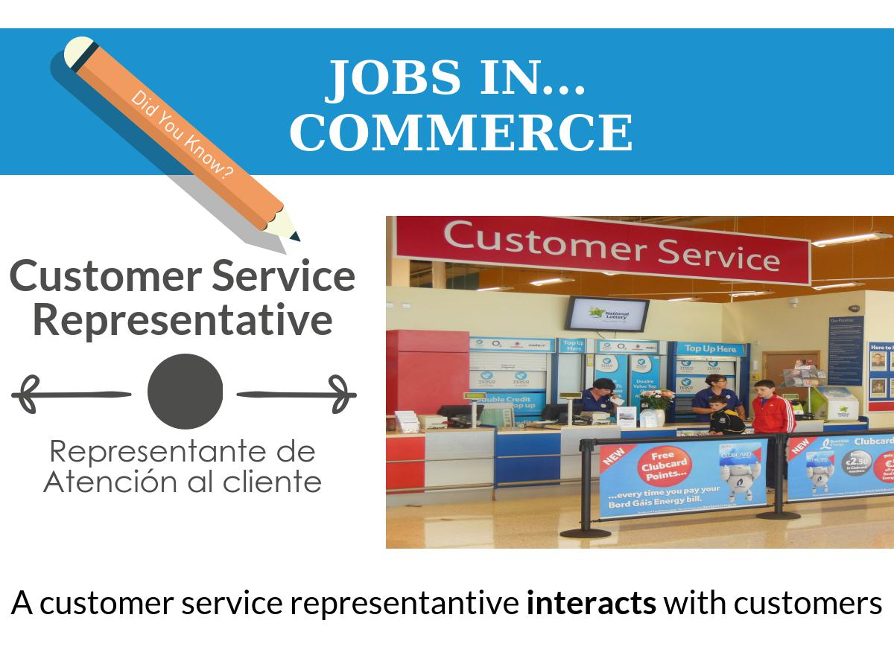

Slide 7
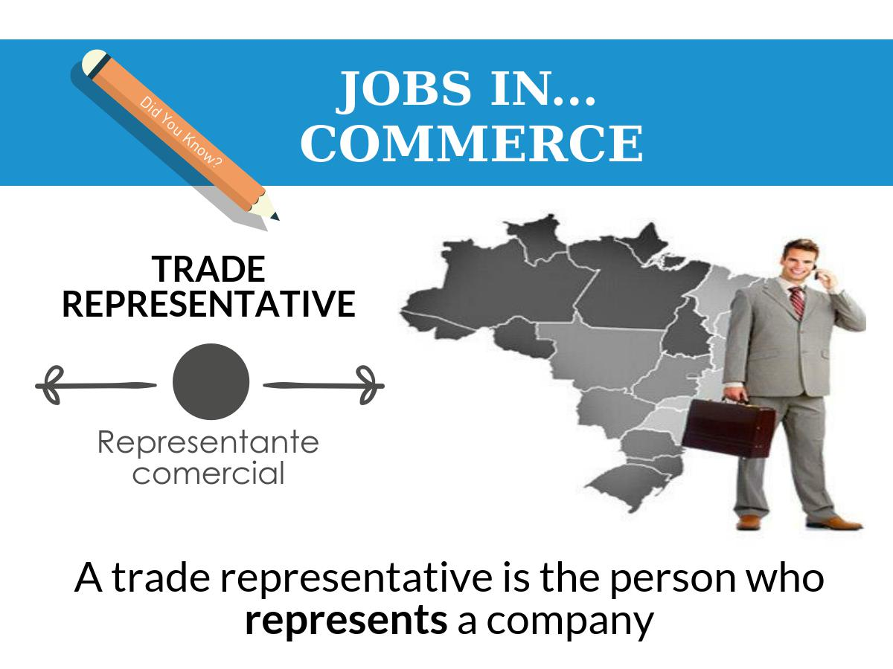

Slide 8


Slide 9
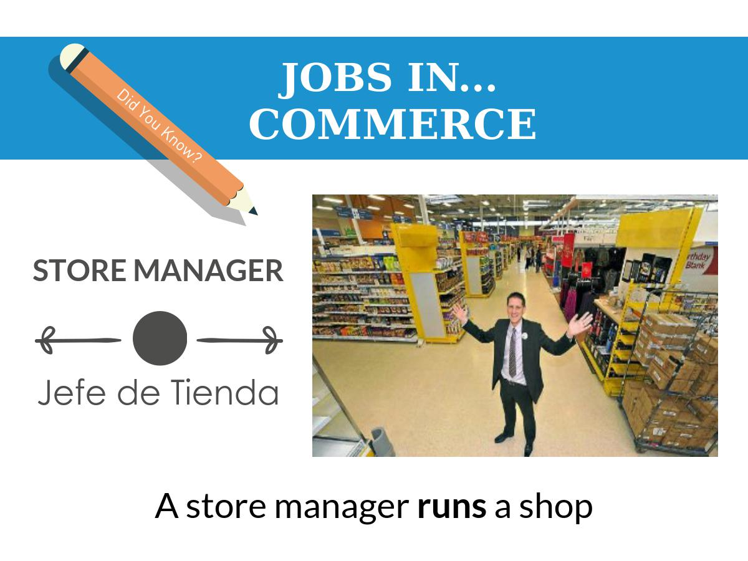

Slide 10


Slide 11


